Slide 1
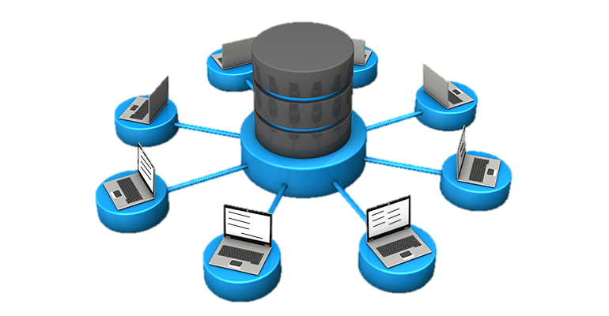
Relational RDBMS
MySQL, PostgreSQL and SQL SERVER

Slide 2

WHAT IS A RELATIONAL DATABASE
A database is a set of data stored in a computer. This data is usually structured in a way that makes the data easily accessible:
And A relational database is a type of database. It uses a structure that allows us to identify and access data in relation to another piece of data in the database. Often, data in a relational database is organized into tables.
Tables can have hundreds, thousands, sometimes even millions of rows of data. These rows are often called records.
Tables can also have many columns of data. Columns are labeled with a descriptive name and have a specific data type.

Slide 3

RELATIONAL DATABASE MANAGEMENT SYSTEM (RDBMS)
A relational database refers to a database that stores data in a structured format, using rows and columns. This makes it easy to locate and access specific values within the database.
It is "relational" because the values within each table are related to each other. Tables may also be related to other tables. The relational structure makes it possible to run queries across multiple tables at once.
=> A relational database management system (RDBMS) is a program that allows you to create, update, and administer a relational database. Most relational database management systems use the SQL language to access the database.

Slide 4
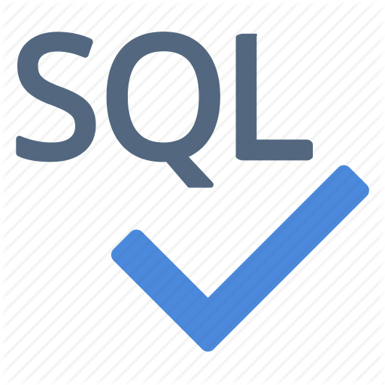
WHAT IS SQL ?
Many RDBMSs use SQL (and variations of SQL) to access the data in tables:
SQL (Structured Query Language) is a programming language used to communicate with data stored in a relational database management system. SQL syntax is similar to the English language, which makes it relatively easy to write, read, and interpret.

Slide 5
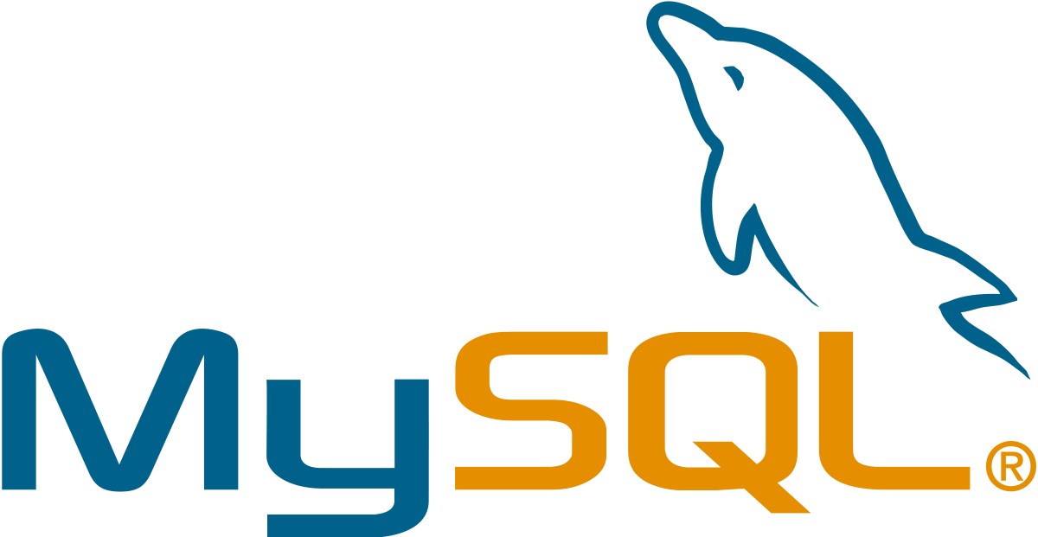
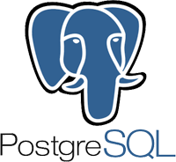
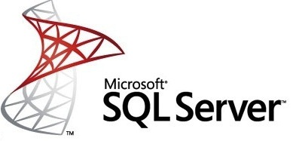
POPULAR RELATIONAL DATABASE MANAGEMENT SYSTEMS
1
MySQL
2
PostgreSQL
3
SQL Server

Slide 6
MySQL
MySQL is the most popular open source SQL database. It is typically used for web application development, and often accessed using PHP.
The main advantages of MySQL are that it is easy to use, inexpensive, reliable (has been around since 1995), and has a large community of developers who can help answer questions.
MySQL follows the working of a client/server architecture. There is a database server (MySQL) and arbitrarily many clients (application programs), which communicate with the server; that is, they can query data, save changes, etc.

Slide 7
PostgreSQL
PostgreSQL is an open source SQL database that is not controlled by any corporation. It is typically used for web application development.
PostgreSQL shares many of the same advantages of MySQL. It is easy to use, inexpensive, reliable and has a large community of developers. It also provides some additional features such as foreign key support without requiring complex configuration.
The main disadvantage of PostgreSQL is that it can be slower in performance than other databases such as MySQL. It is also slightly less popular than MySQL.

Slide 8
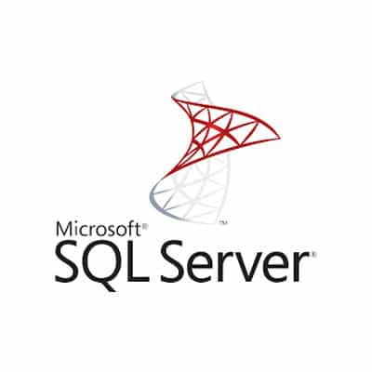
SQL Server
SQL Server : is a relational database management system developed by Microsoft. Large enterprise applications mostly use SQL Server.
Microsoft offers a free entry-level version called Express but can become very expensive as you scale your application.
Microsoft markets at least a dozen different editions of Microsoft SQL Server, aimed at different audiences and for workloads ranging from small single-machine applications to large Internet-facing applications with many concurrent users.

Slide 9
comparison between the three RDBMS
1
2
3
MySQL supports JSON files but doesn’t allow indexing them. Overall, the functionality for JSON files in MySQL is very limited, and developers mostly prefer using classical strings. Similarly to non-relational databases, MySQL also allows working with geospatial data, although handling it isn’t quite as intuitive.
PostgreSQL supports JSON files, as well as their indexing and partial updates. The database supports even more additional data than MySQL. Users can upload user-defined types, geospatial data, create multi-dimensional arrays, and a lot more.
SQL Server also provides full support of JSON documents, their updates, functionality, and maintenance. It has a lot of additional features for GPS data, user-defined types, hierarchical information, etc.
Overall, all three solutions are pretty universal and offer a lot of functionality for non-standard data types. MySQL, however, puts multiple limitations for JSON files, but other than that, it’s highly compatible with advanced data.

Slide 10

comparison between the three RDBMS 1/2
MySQL is the most popular amongst the relational databases and is a widely used one too. Offers a fully-managed database service for Google Cloud platform and is a scalable database with high availability and security at no extra cost.
PostgreSQL is a fully managed and scalable relational database with high availability and security built in at no additional charge. It is a fully managed database service for the Google Cloud Platform. Is better in query optimization and query execution as compared to MySQL. Postgres has a storage engine which is suitable for INSERTand complex search applications such as data mining.
Microsoft SQL Server developed by Microsoft has multiple editions with different feature sets and user profiles. It has some fantastic features like SQL server on Linux, resumable online index build, machine learning services, query processing improvements, and much more.
who is the robust

Slide 11

CONCLUSION
Relational databases store data in tables. Tables can grow large and have a multitude of columns and records. Relational database management systems (RDBMSs) use SQL (and variants of SQL) to manage the data in these large tables. The RDBMS you use is your choice and depends on the complexity of your application.

